Slide 1

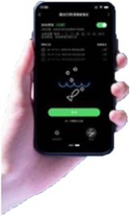
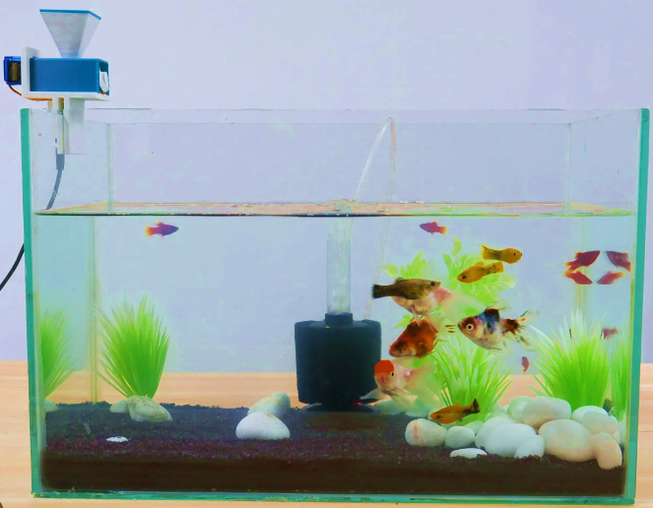
Capstone Project
Auto Aqua-The Smart Aquatic Feeder- Revolutionizing Fish Feeding
Supervisor
Syeda Ajbina Nusrat
Lecturer, Department of CSE
UITS
Presented By
Afia Anjum Id- 2014751124
Zinia Binte Jamal Id- 2014751131
Farjana Sultana Rafi Id-2014751143

Slide 2
Agenda
Introduction
Related Work
Problem Statement
Contribution
Methodology
Experiment
Result
Future Work
Conclusion

Slide 3
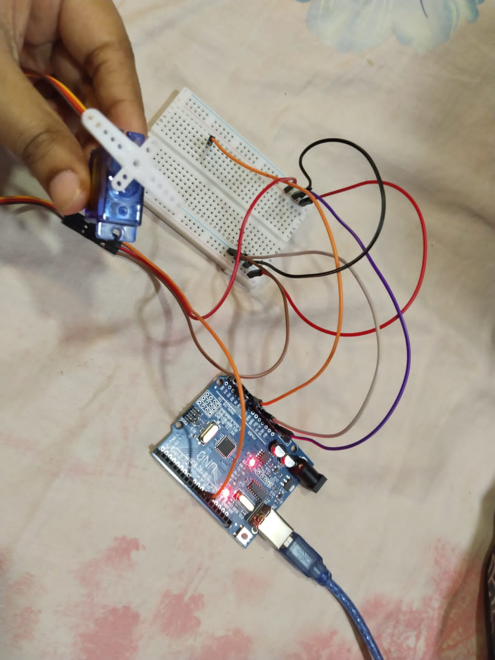
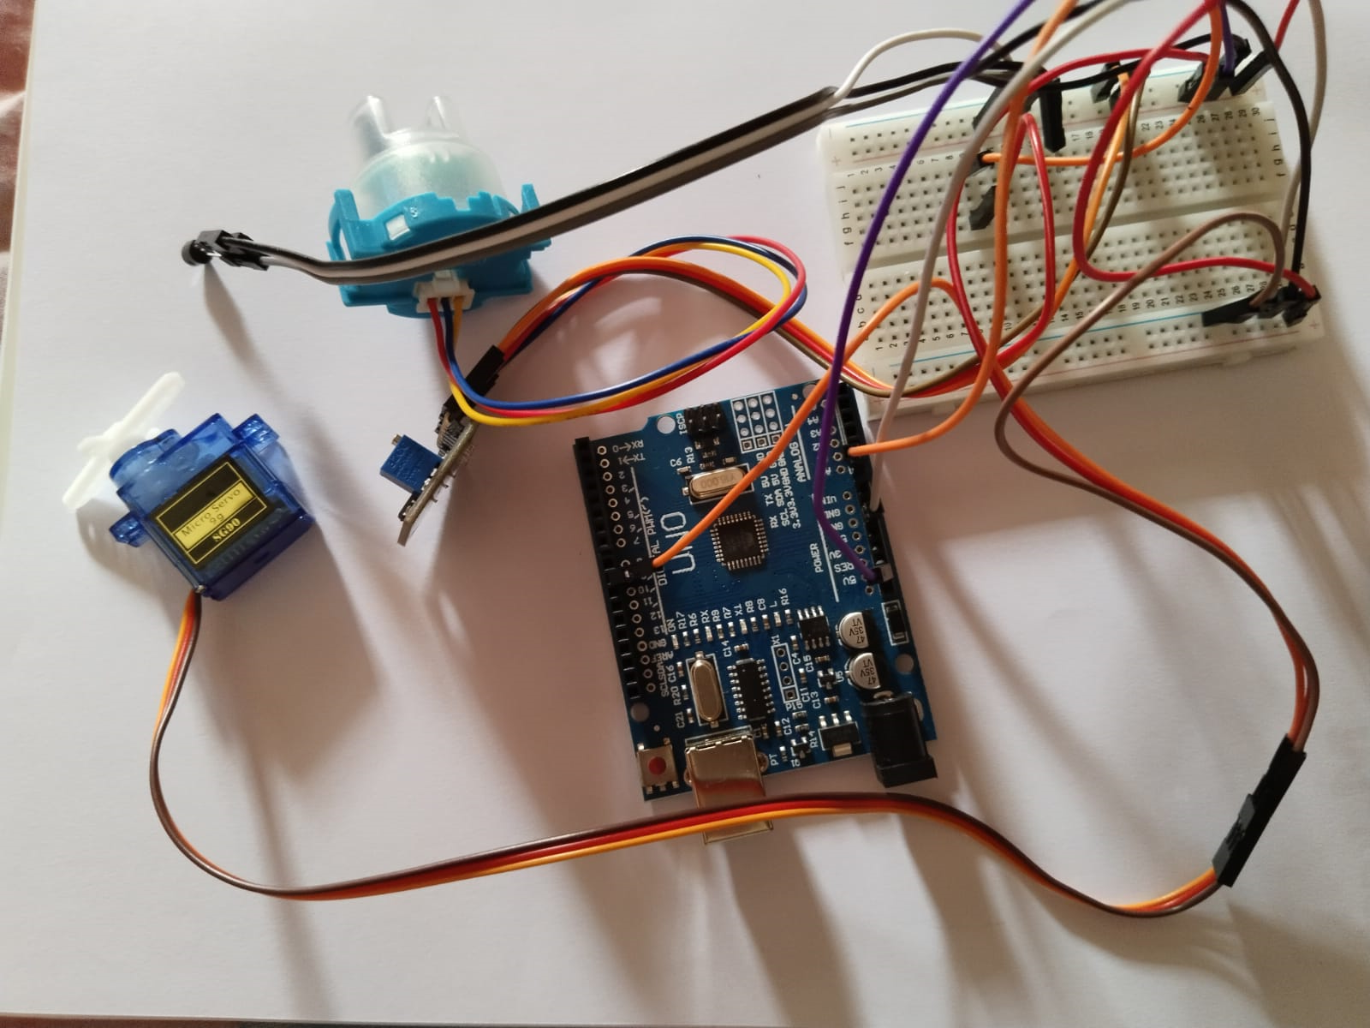
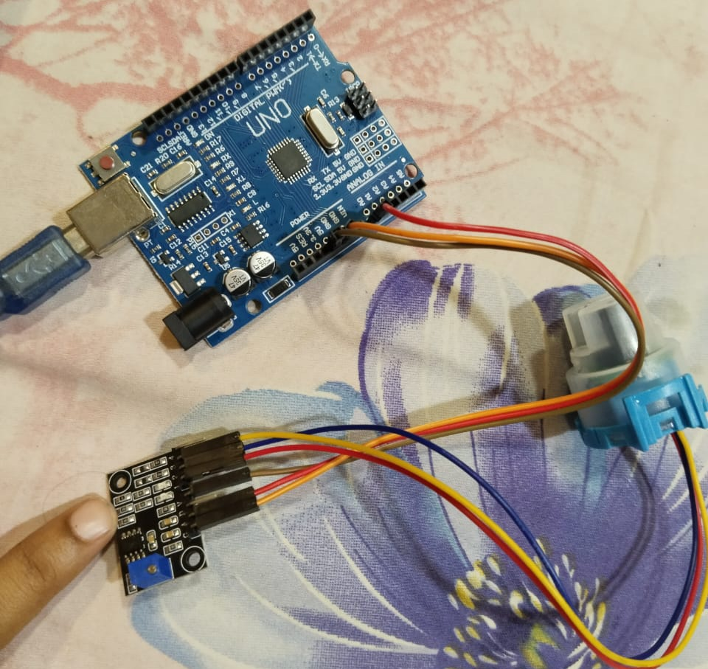
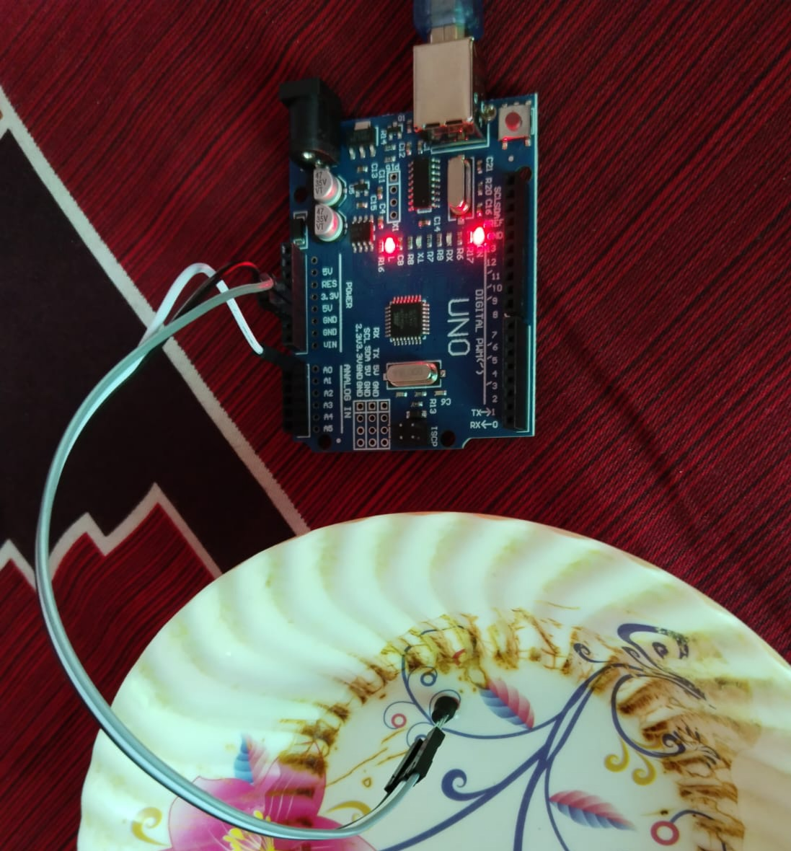
Introduction
Automates fish feeding in aquariums and aquaculture.
Uses sensors, timers, and connectivity.
Scheduled feedings for routine maintenance.
Allows for remote monitoring and control, potentially via a connected application or system.
Figure- 1
Figure- 4
Figure- 3
Figure- 2

Slide 4
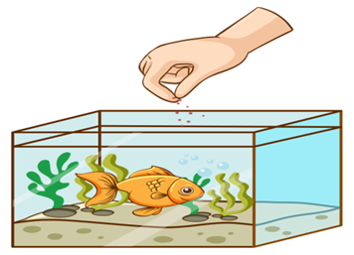
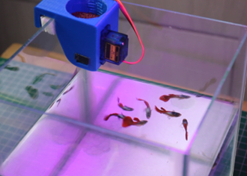
Why we need smart fish feeder?
Timely feeding, supporting fish health.
Preventing overfeeding and water pollution.
Allows scheduled feeding even when owners are absent.
Regular feeding routines reduce fish stress.
Figure- 5: Hand Feeding
Figure- 6: Automatic Feeding

Slide 5
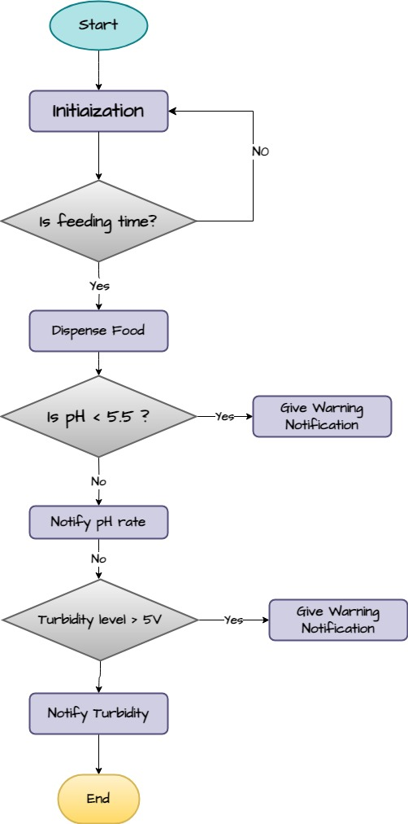
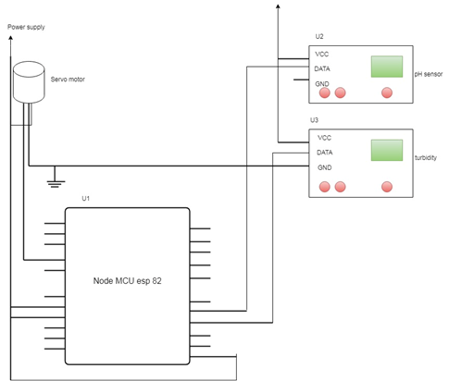
Related Work -1
Unable to determine water temperature.
Utilized an outdated Node MCU model(esp8266).
The cost of this system is very high because of the pH sensor.
Figure- 7: Propose Feeder System Circuit Diagram.
Figure-8: Flow-chart Of Automatic Fish Feeder System
[Reference: Design and Development of Microcontroller Based Automatic Fish Feeder System ISSN 2321 3361 © 2020 IJESC Volume 10 Issue No.4 , Article · May 2020]
https://www.researchgate.net/publication/341113071_Design_and_Development_of_Microcontroller_Based_Automatic_Fish_Feeder_System

Slide 6
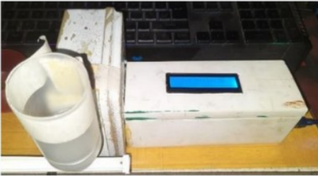
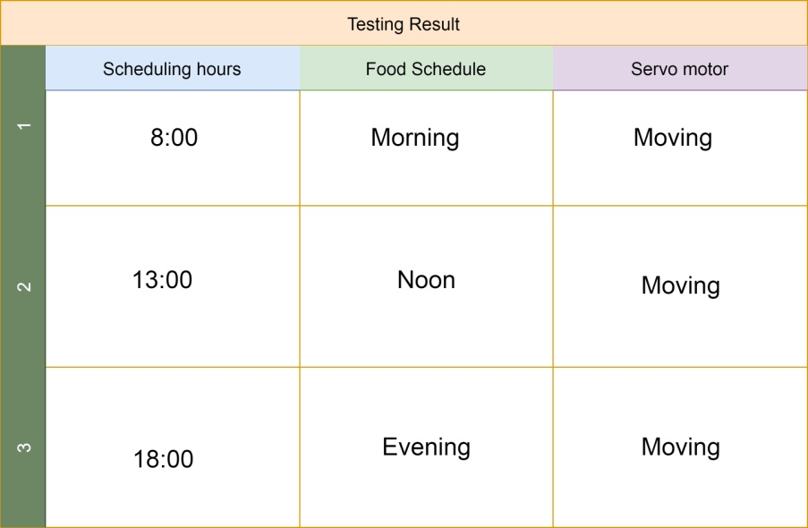
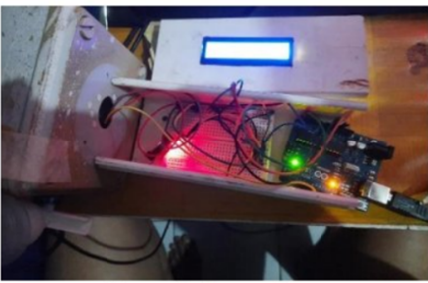
Related work- 2
No manual feeding system.
Water purity and cloudiness cannot be measured.
No wireless connection from a remote place to the control.
Unable to determine water temperature & pH level.
Figure-9: Power off
Figure-10: Power
off
Table 1: Testing result of Scheduled feeding time.
[Reference: Paper2: Automatic fish feeders for fish farming in aquariums based on the Internet of Things (IOT). Jurnal Komputer dan Elektro Sains, Vol.1 No.1, Market 2023, ISSN Online xxxx-xxxx, DOI : https://doi.org/10.58291/komets.v1i1.98]
https://ejournal.sultanpublisher.com/index.php/komets/article/view/98/47

Slide 7
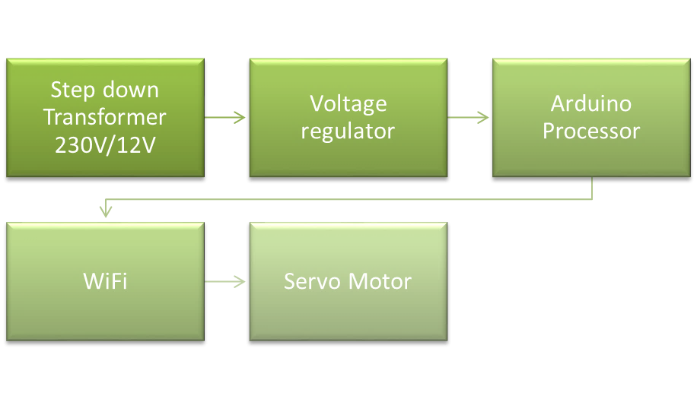
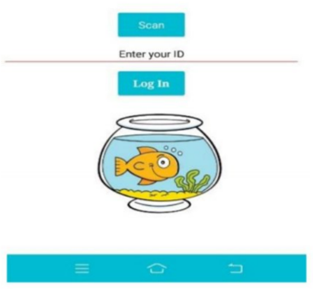
Related Work -3
Used a step-down transformer to control the servo motor motion.
Utilized a step-down transfer that wasn't necessary.
Can't quantify water filtration.
Absence of manual control.
Dispatch
the food fish
Figure- 11: Proposed System Integrated With The MIT App Interface Login
Figure- 12: Block Diagram Representing Of The Proposed System.
[Reference: IoT Based Fish Food Dispenser. 2023 9th International Conference on Advanced Computing and Communication Systems (ICACCS)]
https://ieeexplore.ieee.org/abstract/document/10113051?fbclid=IwAR3b8VW1FK5X79lF04HagHNYoT-np_rQ0DXoCQIE5BqKnxQXGpek2TEesyY

Slide 8
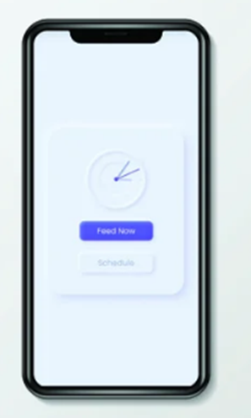
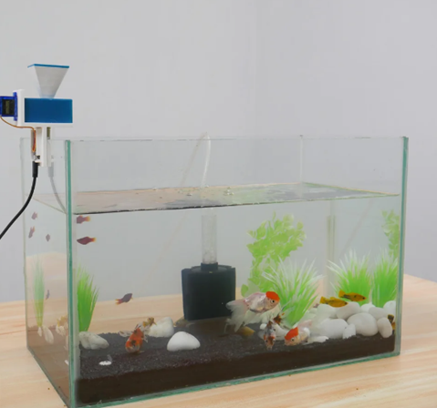
Related Work - 4
Web apps have been used to control the feeding device.
A Firebase real-time dataset was utilized (difficult to establish).
The designed web app has been raising the cost.
No water quality sensor has ever been employed.
Figure-13: Automatic Fish Feeder Using Companion App.
Figure- 14: Web-App
[Reference: Quasits : DIY Automatic Fish Feeder With Companion App By Coders Café Tech.]
nstructables.com/Aquassist-DIY-Automatic-Fish-Feeder-With-Companion/?fbclid=IwAR1mmOQoAbCm4XG6KUiGXt91s-23ZsoTo0hy5YBmvwoYMVeUCsMPpbfvJcc

Slide 9
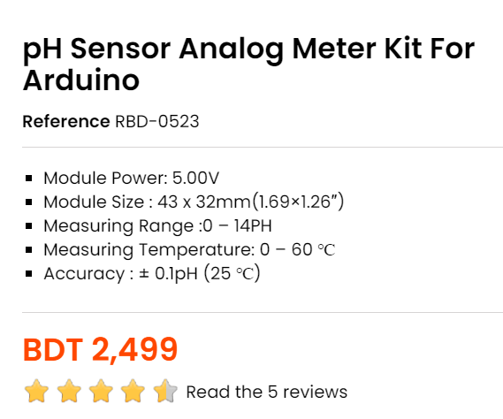
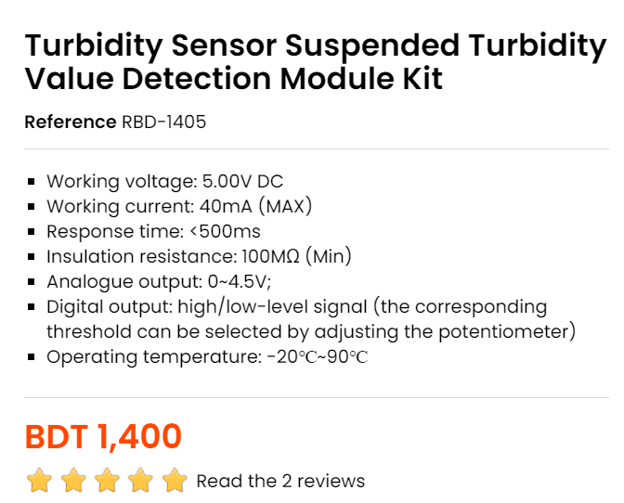
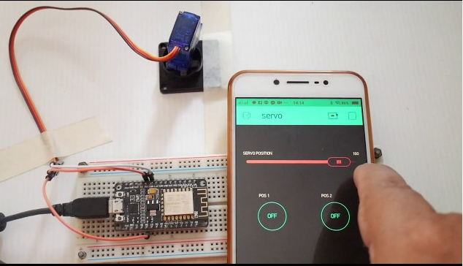
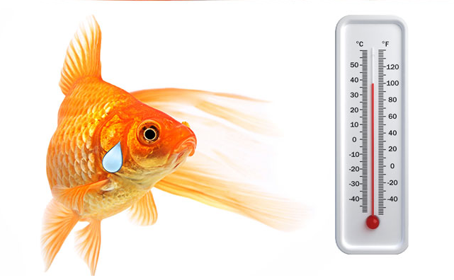
Problem Statement
Cost-Efficiency with Turbidity Sensor.
Temperature Sensor for rearing healthy fish.
Software with Mobile App.
Affordability for Customers.
User-friendly , easy to manage system.
Figure-15: Increase cost efficiency
Figure-16: User-friendly and easy to handle
Figure-17: Aquarium fish can’t survive in more than 30 degree

Slide 10
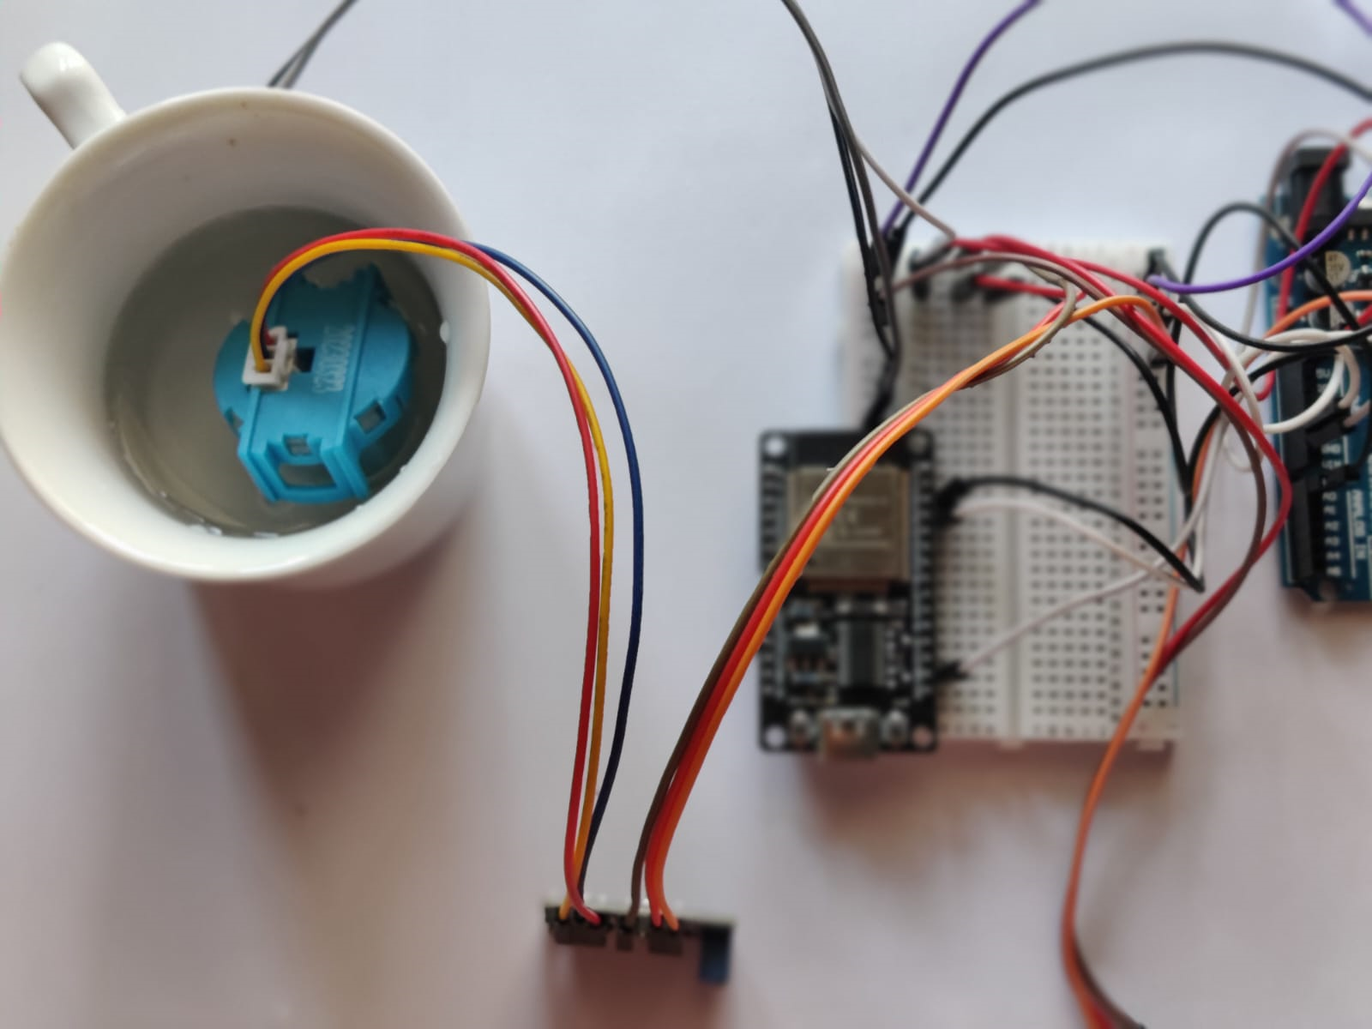
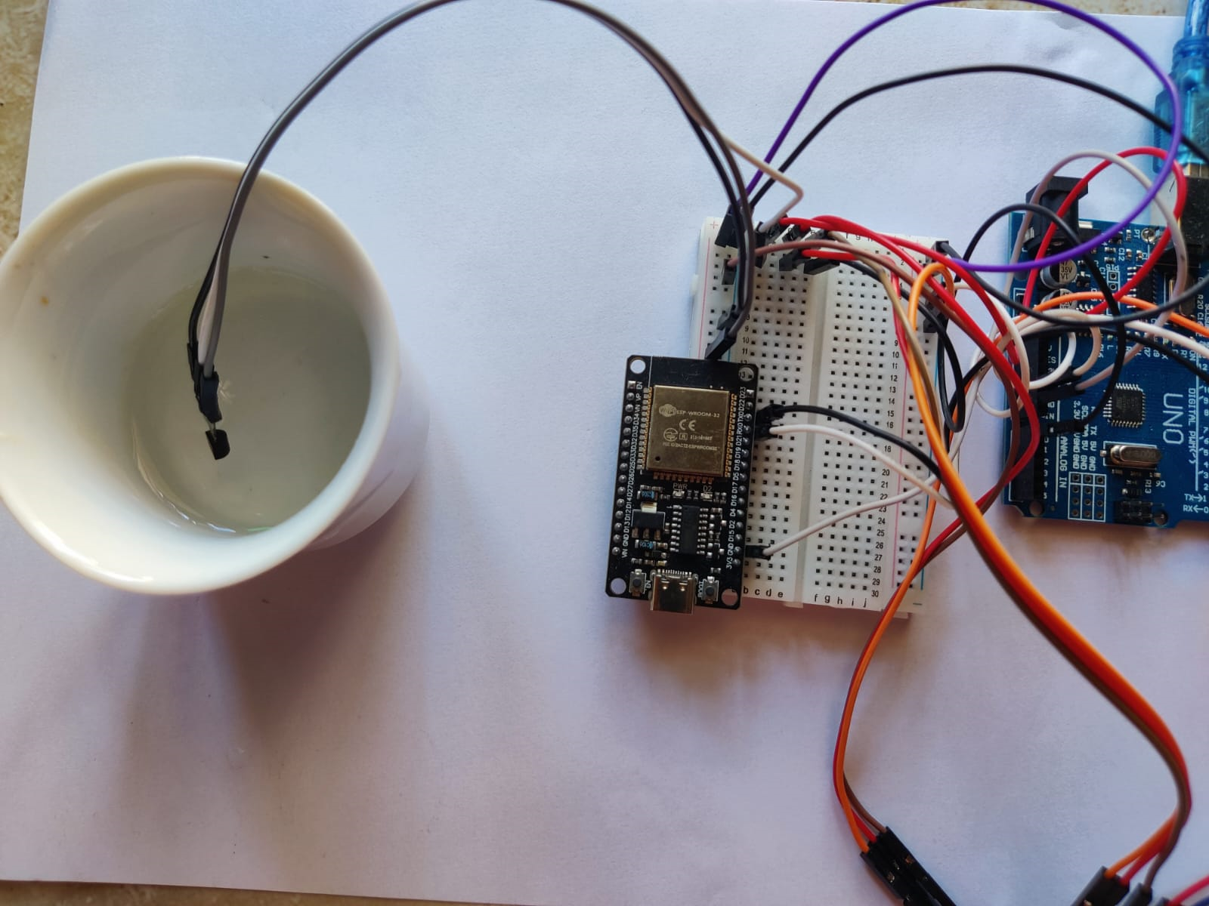
Contribution
The fish mortality rate is reduced
Water purity and cloudiness can be inspected by using a turbidity sensor.
No web base cost , used a built-in app.
Produced budget friendly project.
Figure- 18: Using Turbidity Sensor
Figure- 20: Reduced cost in our project
Figure- 19: Using Temperature Sensor

Slide 11
Experiment
Hardware | Specification
ESP32 | CH340 - USB-C
Arduino | R3 SMD
Mini Servo | SG90
Breadboard | MB102
Temperature Sensor | TMP36
Turbidity Sensor | DC5V
Jumper Wire | Male to Male & Male to Female
Table 2:Hardware with specification
Software | Specification
Android and ioS | Blynk app
Table 3:Software Specification

Slide 12
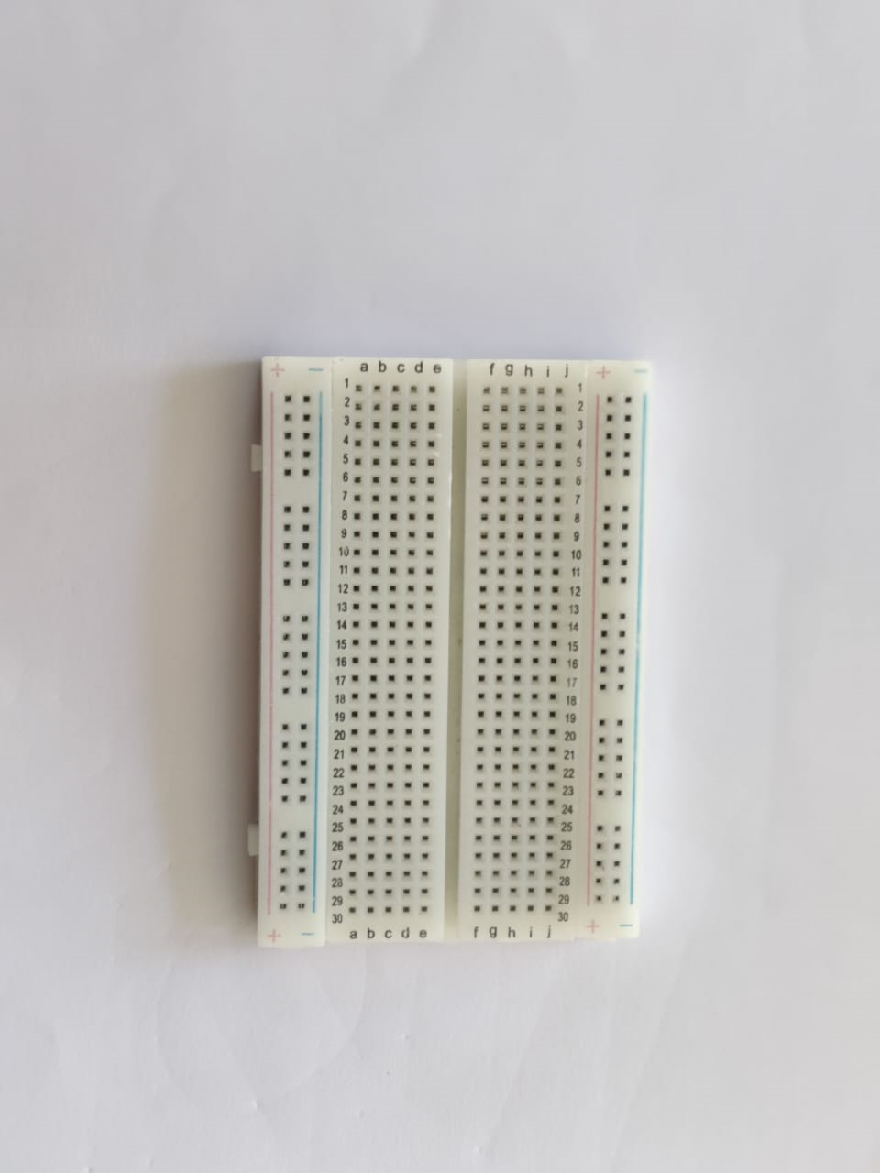
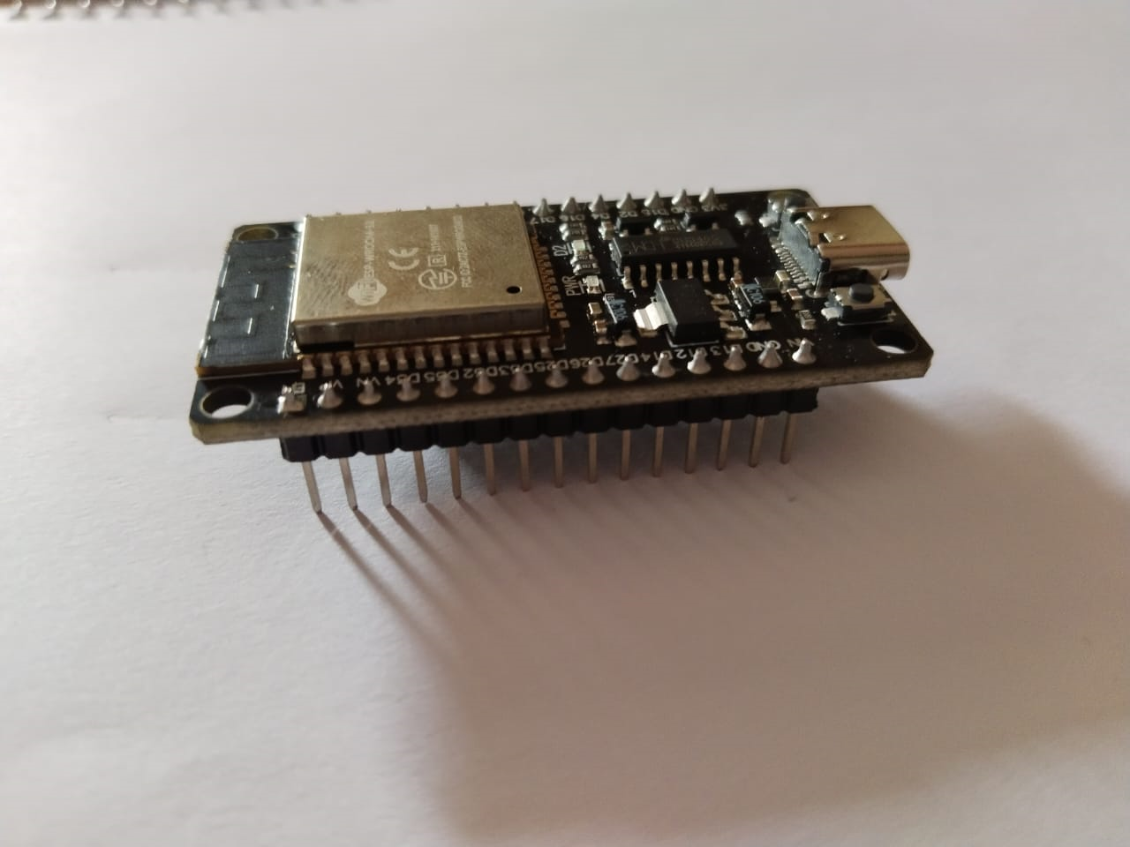
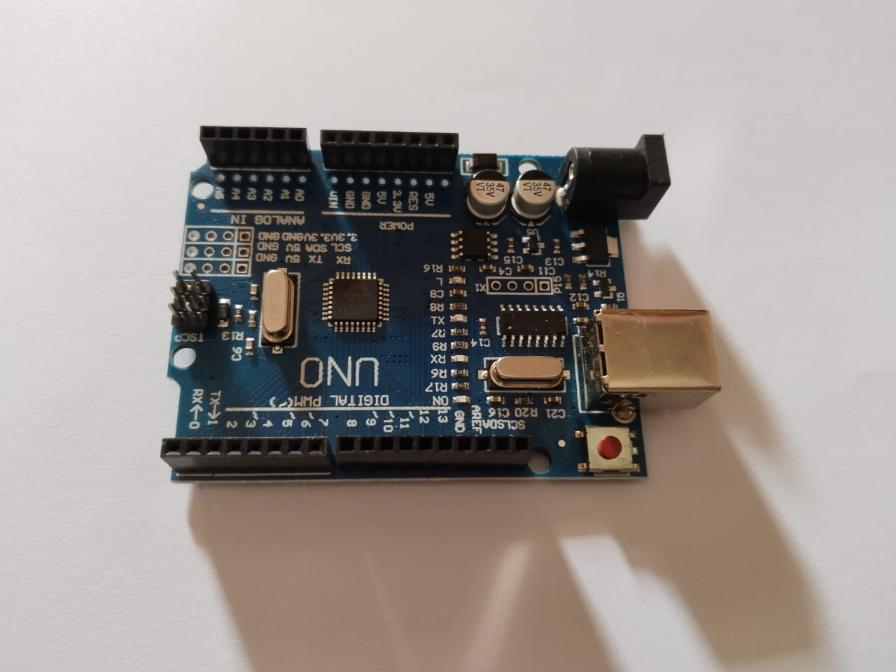
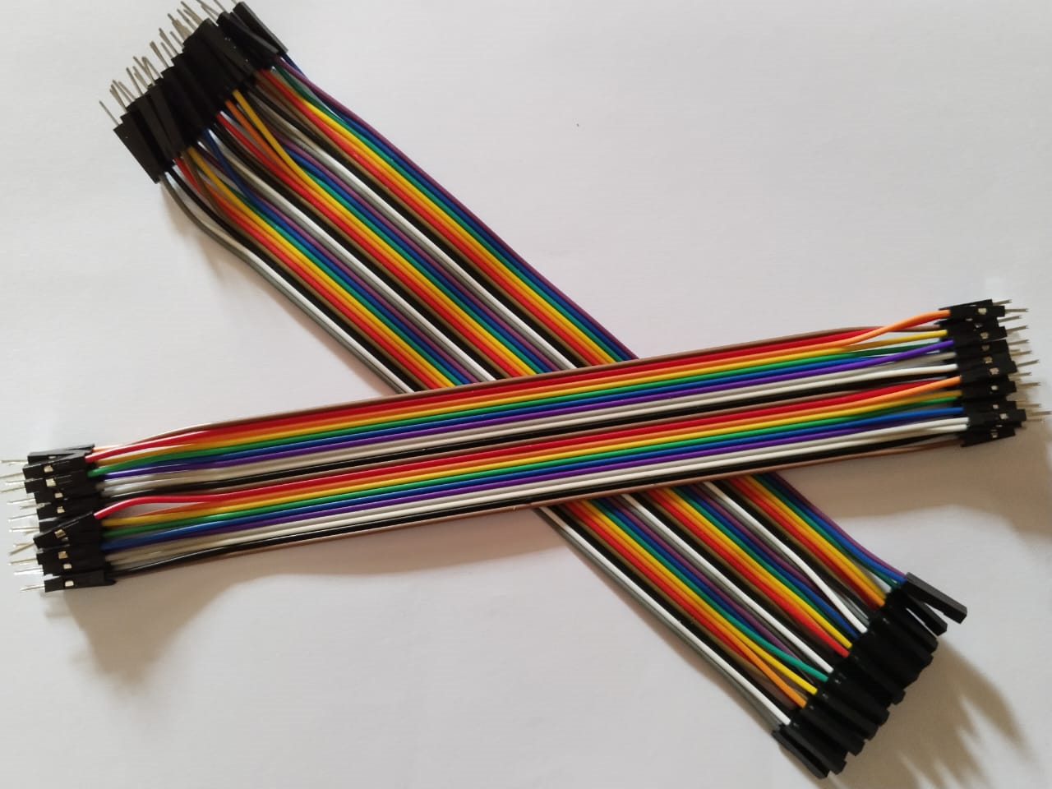
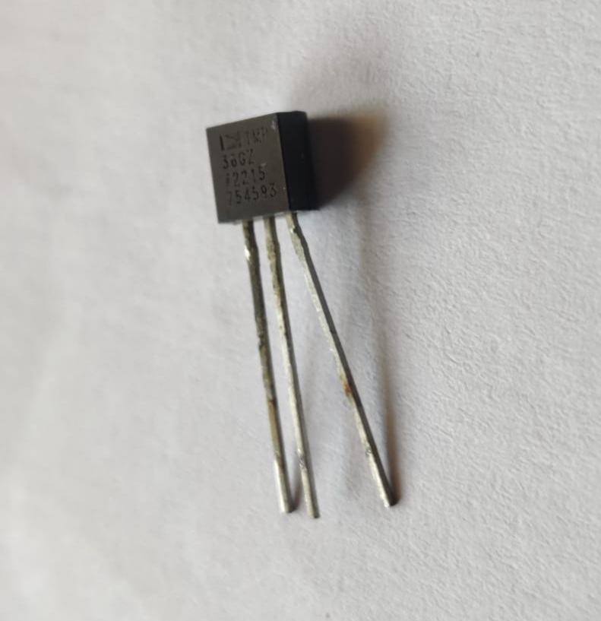
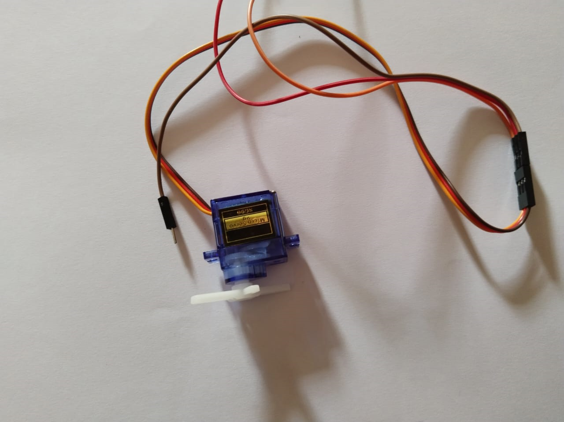
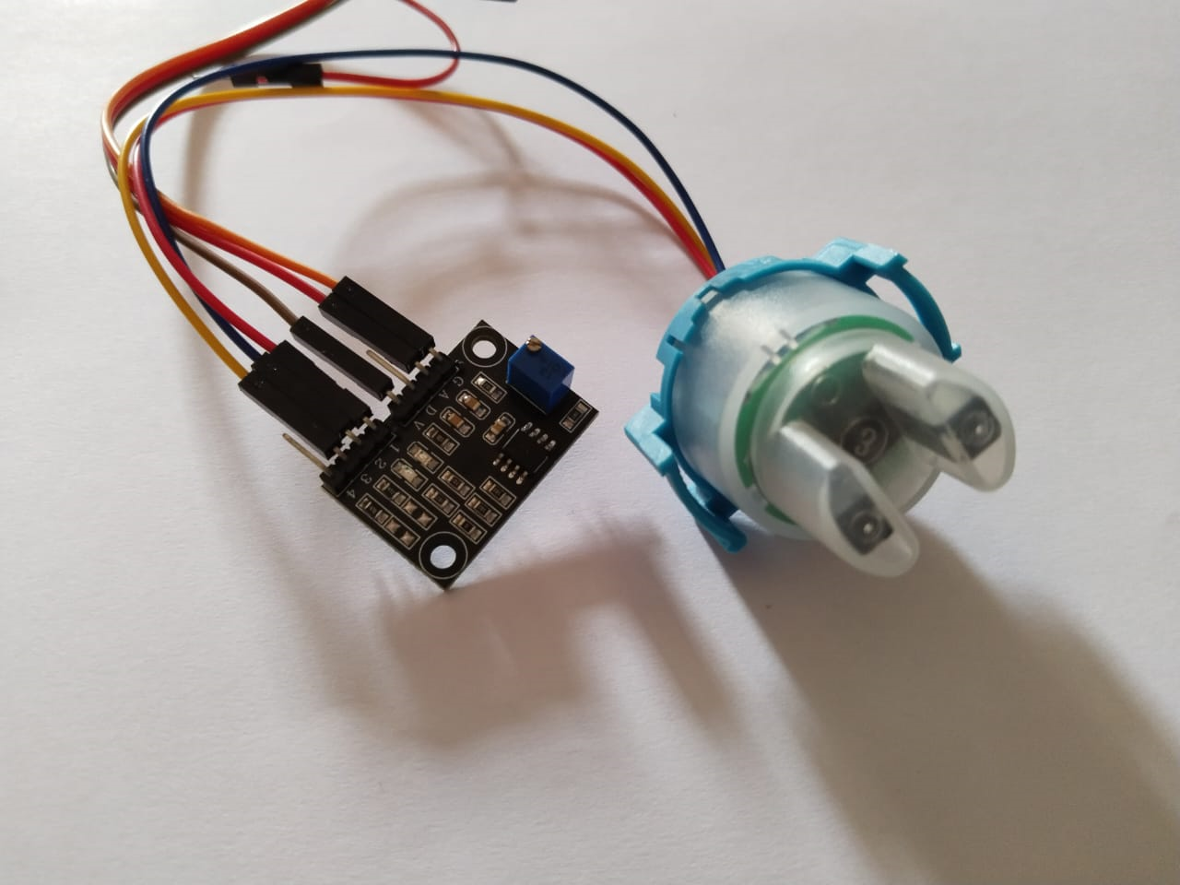
Hardware
Figure-21 : Esp 32
Figure- 22: Arduino
Figure- 23: Breadboard
Figure- 24: Jumper Wire
Figure- 25: Temperature
Figure- 26: Servo Motor
Figure- 27:Turbidity Sensor

Slide 13

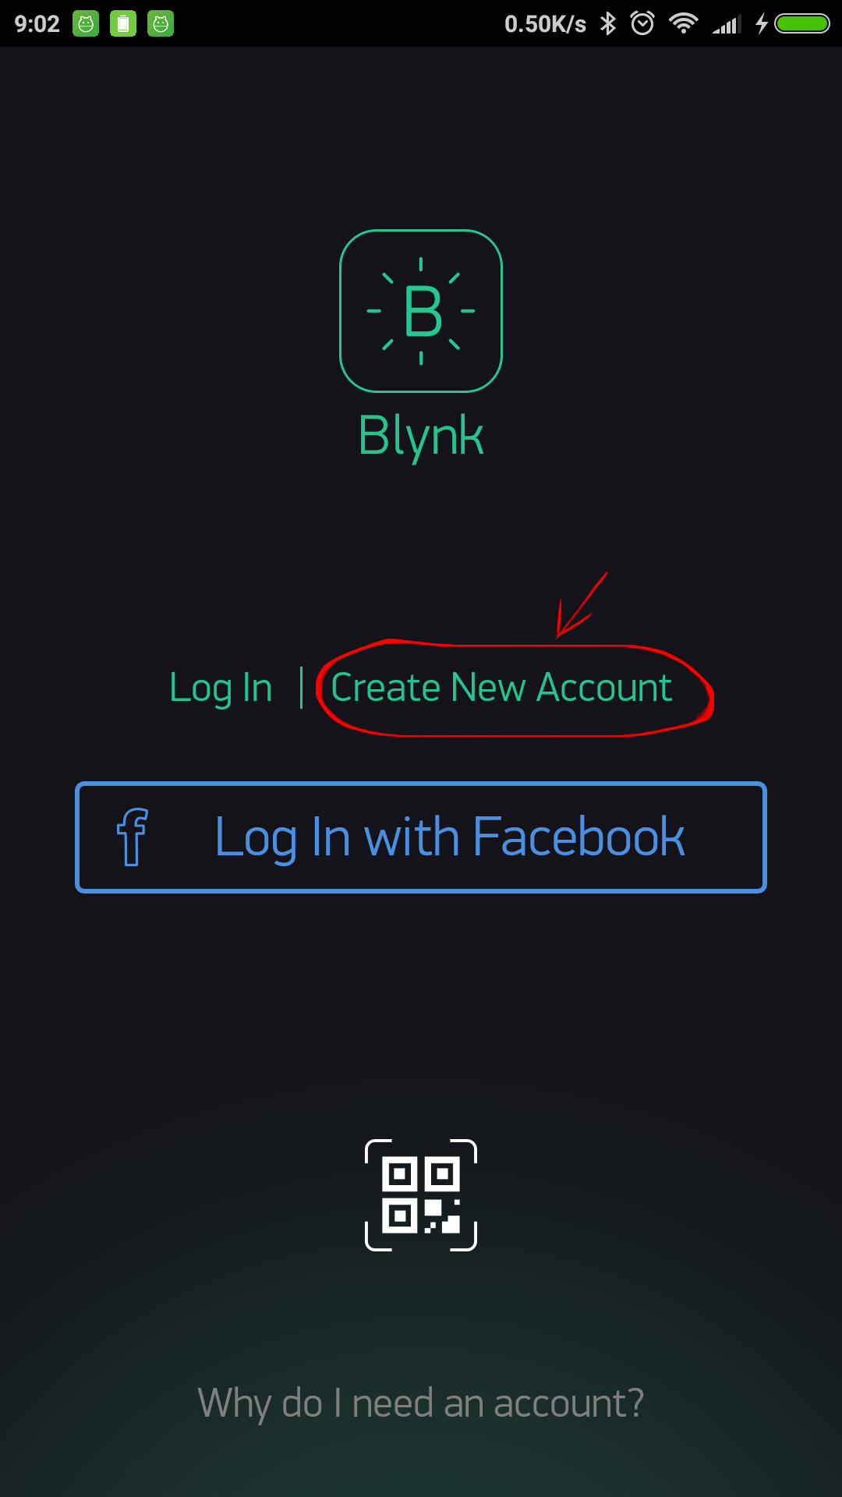

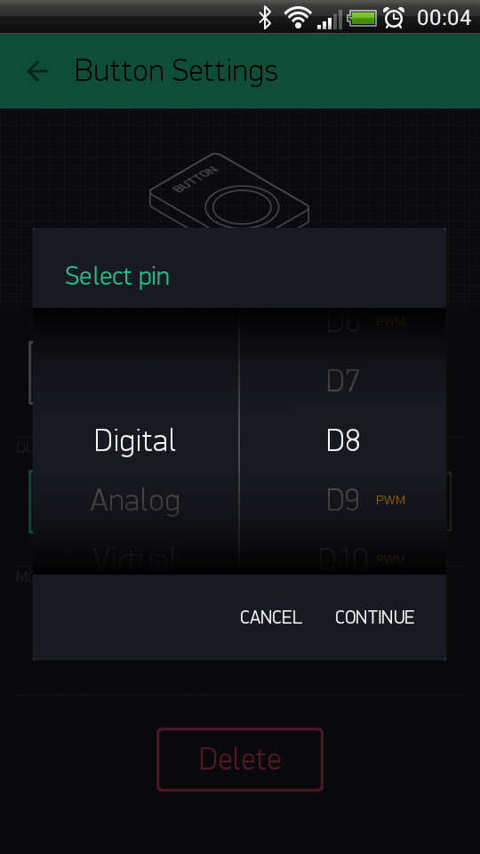
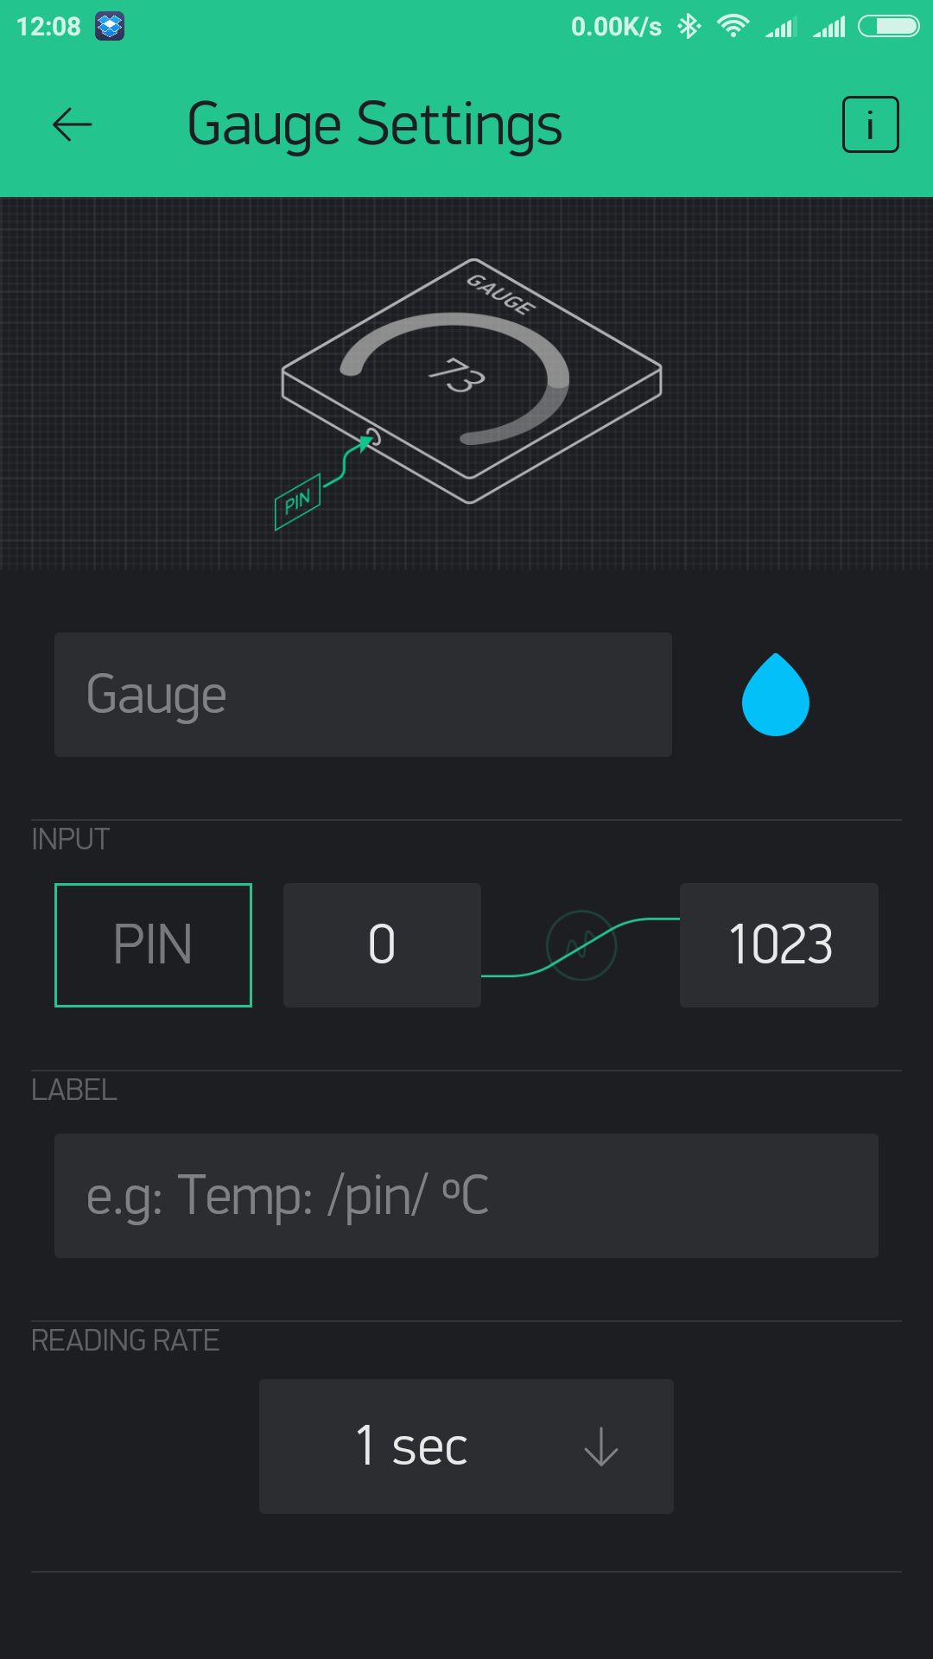
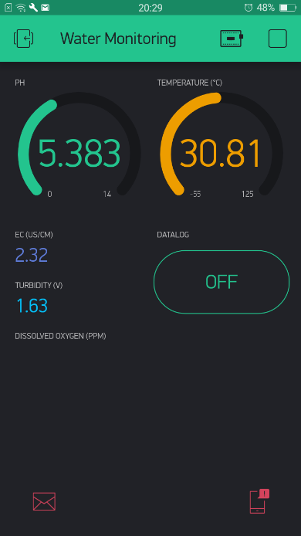
Software
Figure-29:Blynk app works process

Slide 14
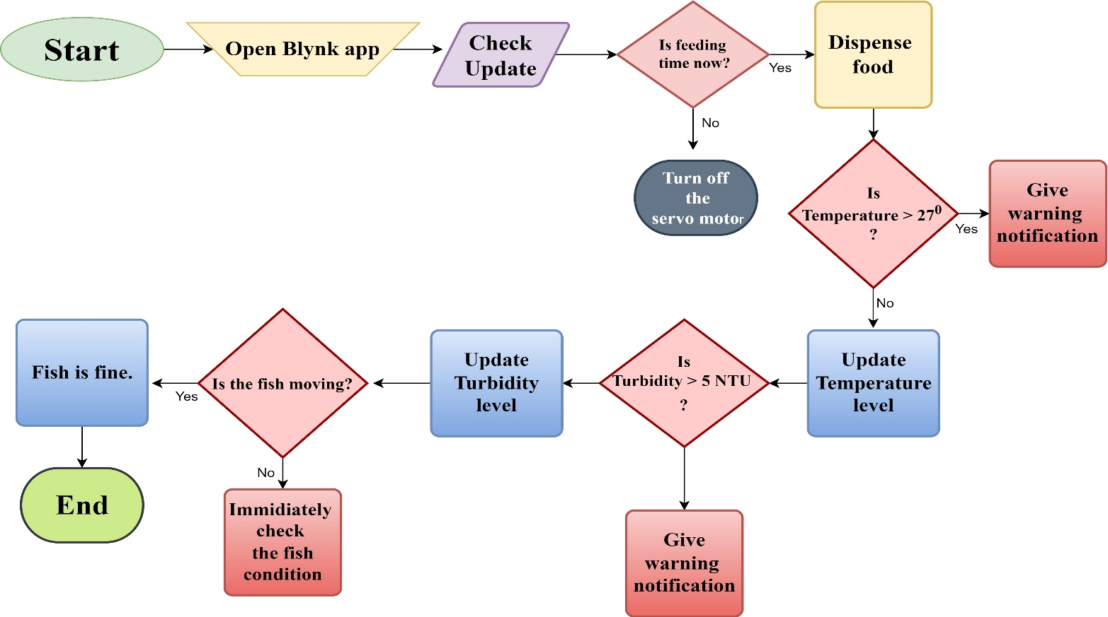
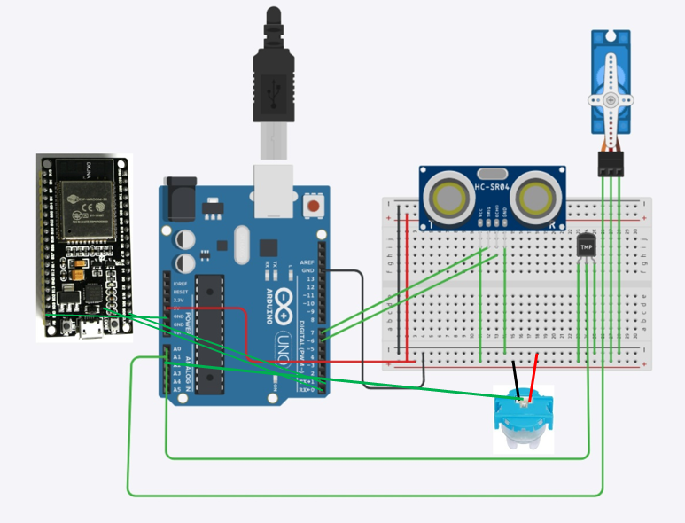
Proposed Method
About The automated system:
Designing compact, weather-resistant feeder with programmable control and storage.
Implementing adjustable feeding schedule for customization.
Exploring IoT integration for enhanced connectivity across aquaculture systems.
Figure-30:Flow chart of our proposed method
Figure-31:Circuit diagram of our project

Slide 15
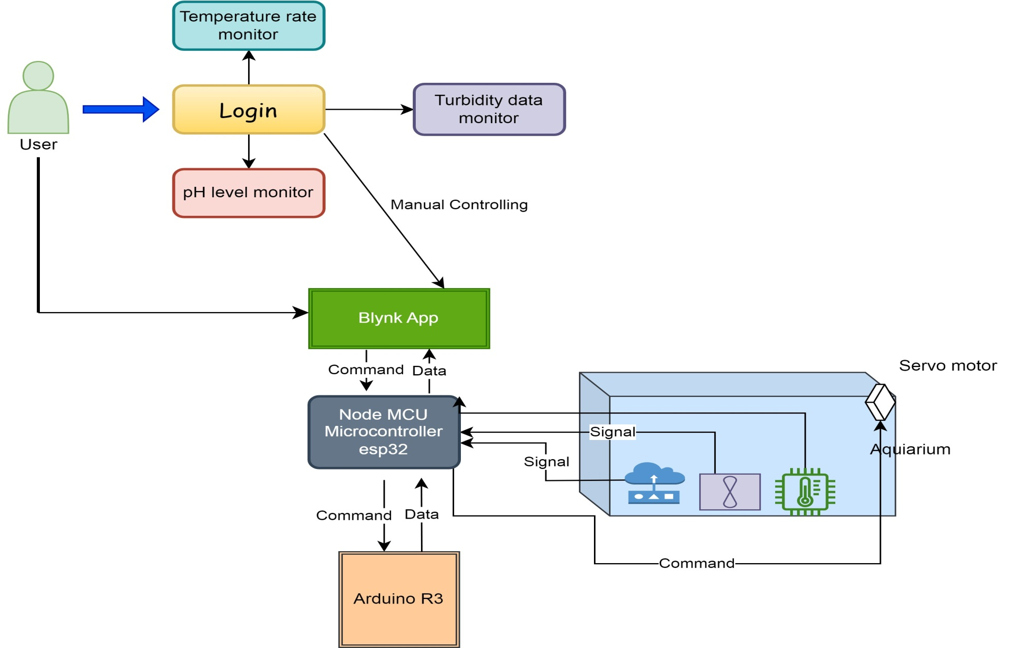
User-friendly automated fish feeder system
I should change the water
Feed now
Figure-32: Use case diagram of automated fish feeding system.

Slide 16
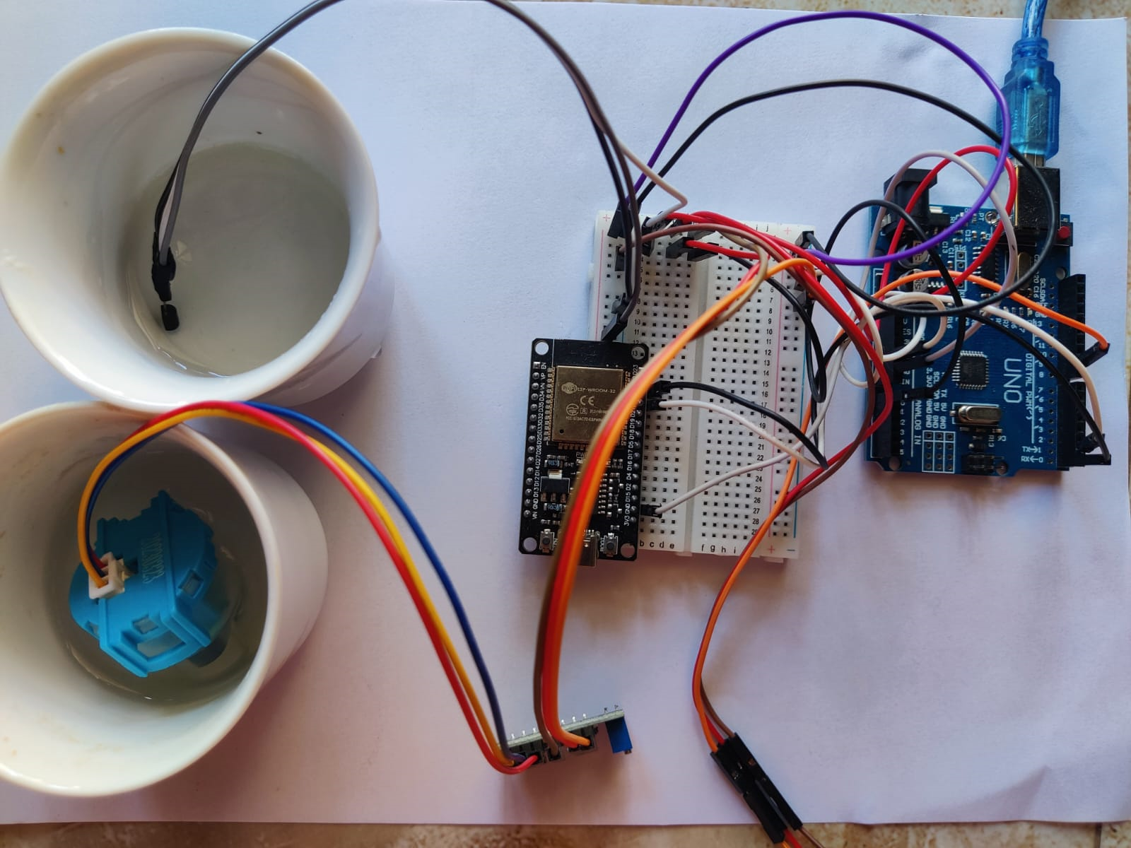
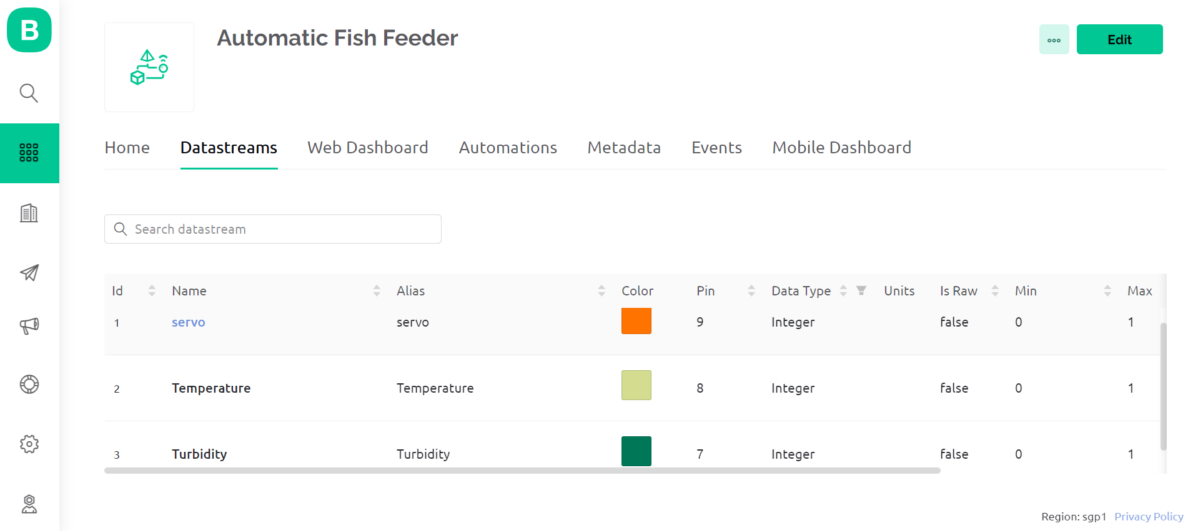
Project Achievements
Connection Between Hardware & Software
The Servo motor and sensors are connected to Arduino UNO R3.
Arduino UNO R3 is connected to Node MCU esp32.
Node MCU connects hardware with the Blynk app through code implementation.
Figure-33:Connecting between the hardware & software

Slide 17
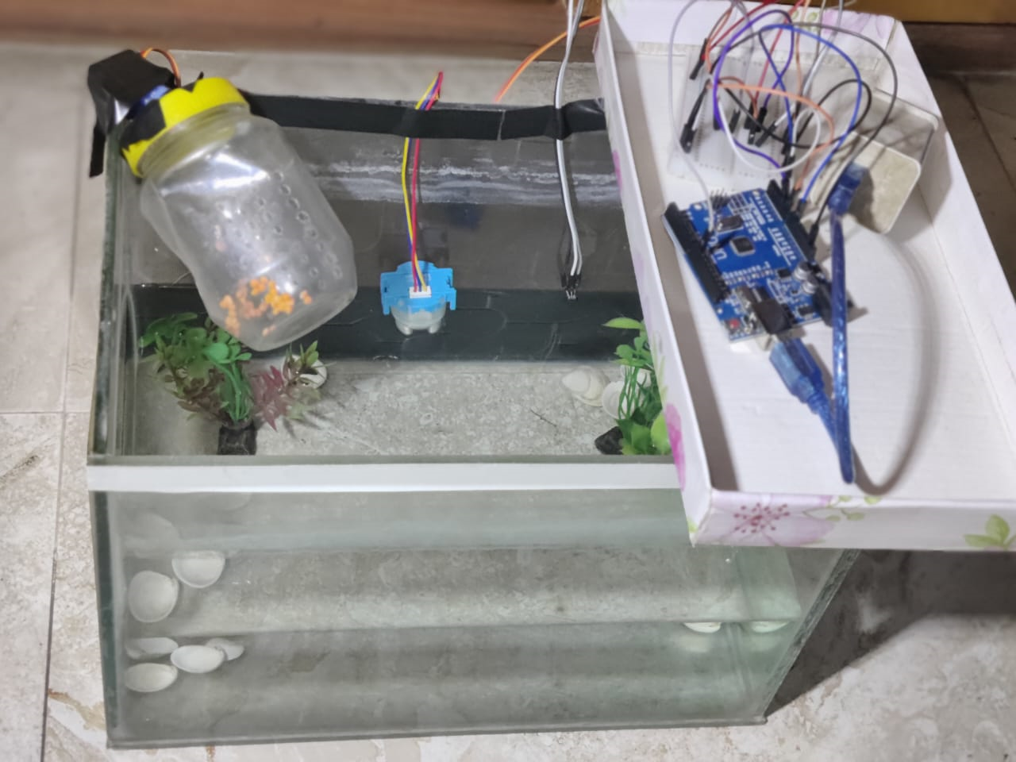
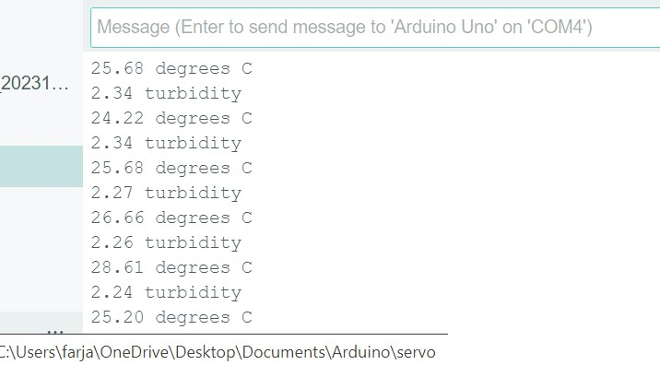
Result
Effective operation of fish feed control system with automatic servo activation confirmed.
Temperature sensor tracks aquarium water temperature for optimal fish tank conditions.
Turbidity sensor ensures water clarity monitoring.
Figure 34: Prototype and Simulation

Slide 18
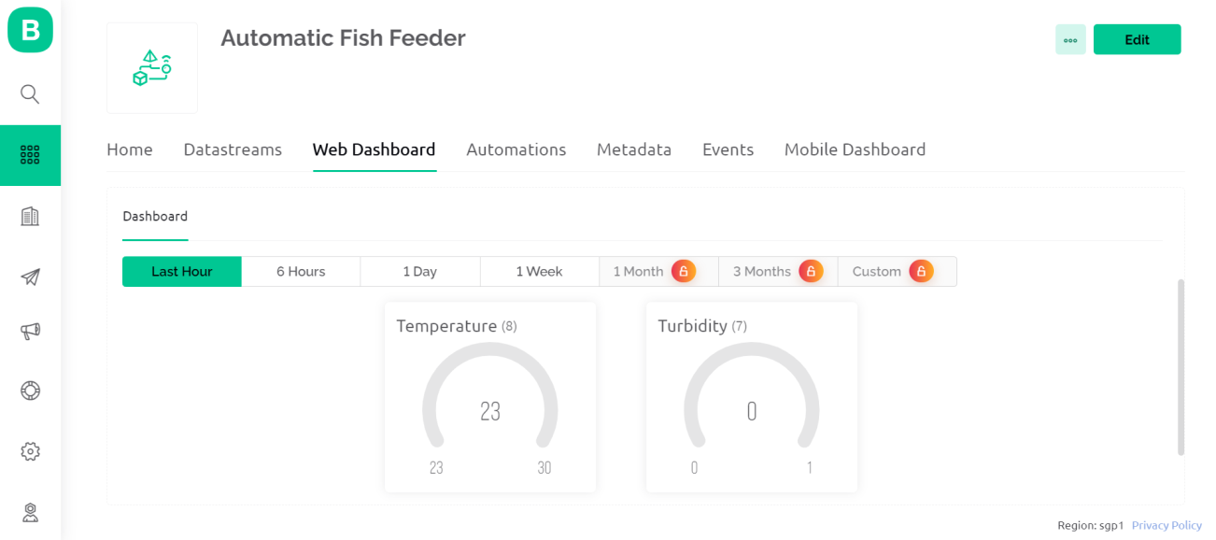
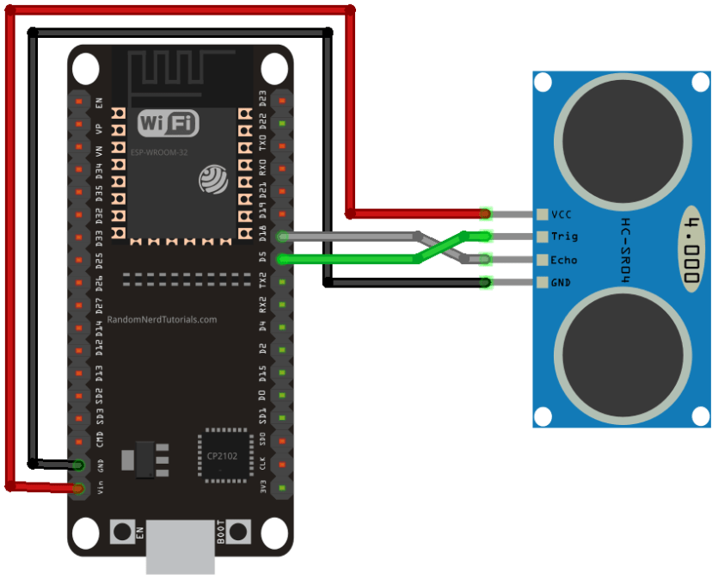
Future Work
The process of establishing a connection with the Blynk App, a mobile application used for building IoT projects is currently underway.
Connecting Ultrasonic sensor to detect the movement of fish.
Figure-35: Connecting Blynk App with Hardware
Figure -36: Connecting Ultrasonic sensor with Esp32

Slide 19
Conclusion
Smart fish feeding revolutionizes traditional aquaculture using technology for optimized practices.
Integration of technology with fisheries management enhances industry efficiency and sustainability.
Our efforts advance aquaculture, driving greater efficiency, sustainability, and prosperity.

Slide 20



Slide 21

Any Question?

